Slide 1
DQL:
SELECT Statement
SELECT identifies the columns to be displayed.
FROM identifies the table containing those columns.
SELECT [DISTINCT] *,column [alias],...
[FROM table];
In the above syntax:
SELECT Is a list of one or more columns
* Selects all columns
DISTINCT Suppresses duplicates
Column | Expression Selects the named column or the expression
alias Gives different headings to the selected columns
FROM table Specifies the table containing the columns

Slide 2
Selecting All Columns
You can display all columns of data in a table by following the SELECT keyword with an asterisk (*).
In the example in the slide, the DEPT table contains four columns: DEPTNO, DNAME, MGR, and LOC. The table contains four rows, one for each department.
SELECT * FROM dept;
You can also display all columns in the table by listing them after the SELECT keyword.
For example, the following SQL statement will display all columns and all rows of the DEPT table:
SELECT DEPTNO, DNAME, MGR, LOC FROM dept;

Slide 3
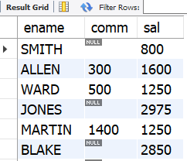
Null Value in MySQL
Null is a value that is unavailable, unassigned, unknown, or inapplicable.
Null is not the same as zero or a blank space.
If a row lacks a data value for a particular column, that value is said to be NULL or to contain a null.
Eg:
select ename,comm,sal from emp;

Slide 4
Defining a Column Alias
A column alias:
Renames a column heading and is case sensitive.
Is useful with calculations.
Immediately follows the column name (there can also be the optional AS keyword between the column name and the alias).
Requires double quotation marks if it contains spaces or special characters.
Eg:
select empno as id,ename as name from emp;
select sal*12 as "Annual Salary" from emp;
select 12*12 calculation;

Slide 5
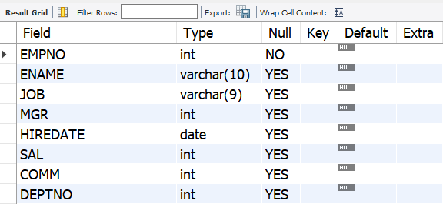
Displaying Table Structure
Use the DESCRIBE command to display the structure of a table.
SYNTAX:
DESC[RIBE] tablename
Eg:
DESCRIBE EMP;

Slide 6
Restricting Data
SELECT [[DISTINCT] * [, column [alias],...}]
FROM table]
[WHERE CONDITION(s)];
The WHERE clause is used to filter records | rows.
It is used to extract only those records that fulfill a specified condition.
The WHERE clause is not only used in SELECT statements, it is also used in UPDATE, DELETE
It consists of three elements:
• Column name
• Comparison condition
• Column name, constant, or list of values

Slide 7
Comparison operators are used in conditions that compare one expression with another value or expression.
They are used in the WHERE clause in the following format:
Syntax
... WHERE expr operator value
select ename ,sal,job,deptno from emp where sal=1250;
select ename ,sal,job,deptno from emp where sal<>1250;
select ename ,sal,job,deptno from emp where sal>3000;
select ename ,sal,job,deptno from emp where sal<1250;
Use BETWEEN operator to display rows based on a range of values:
Eg:
select ename ,sal,job
from emp
where sal between 1000 and 3000;

Slide 8
Use IN operator to test for values in a list:
Eg:
select ename,hiredate,job from emp where job in('clerk','salesman’);
select ename,sal,deptno from empwhere deptno in (10,20);
Use IS NULL operator to tests for nulls:
Eg:
select * from emp where comm is null;
A null value means that the value is unavailable , unassigned, unknown, or inapplicable.
Therefore, you cannot test with =, because a null cannot be equal or unequal to any value.

Slide 9

Defining Conditions Using Logical Operators
Operator | Meaning
AND | Returns TRUE if both component conditions are true
OR | Returns TRUE if ONE component conditions are true
NOT | Returns TRUE if the condition is false
A logical condition combines the results of two or more component conditions to produce a single result based on those conditions, or it inverts the result of a single condition.
A row is returned only if the overall result of the condition is true.
Eg:
Display the name,salary,department id ,job of all those employees working in department no. 10 as clerk.
select ename , sal , job, deptno
from emp
where deptno =10 and job='clerk';

Slide 10
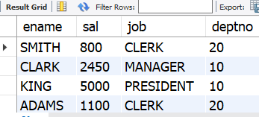
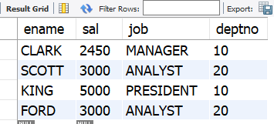
Example:
Display the name,salary,department id ,job of all those employees working in department no. 10 and all employees working as clerk.
select ename , sal , job, deptno
from emp
where deptno =10 or job='clerk';
Display the name,salary,department id ,job of all employees except those working as clerk and salesman .
select ename,sal,job,deptno
from emp
where job not in ('clerk','salesman');

Slide 11
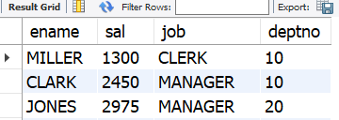
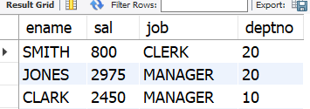
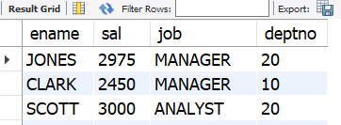
Display the name , salary, department id ,job of the employees working in department no. 20 and 10 whose monthly salary greater than 2000.
Query1:
select ename,sal,job,deptno from scott.emp where sal>2000 and deptno =20 or deptno=10 ;
Query2:
select ename,sal,job,deptno from scott.emp where deptno =20 or deptno=10 and sal>2000;
Query3:
select ename,sal,job,deptno
from scott.emp where sal>2000
and (deptno =20 or deptno=10) ;

